Slide 1
Machine Learning models with Natural Language Processing as a usable online tool for fake news identification
2467273S

Slide 2

Motivation
Fake News spread all over the Internet
Human accuracy – 54%
Trove of literature available online about similar models, but no tools available

Slide 3
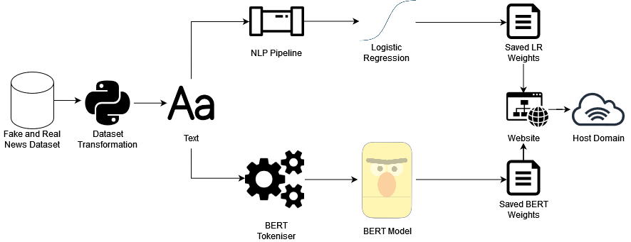
Design
Dataset analysis
Information extraction
Text transformation
Model training
Web application development
Online domain

Slide 4
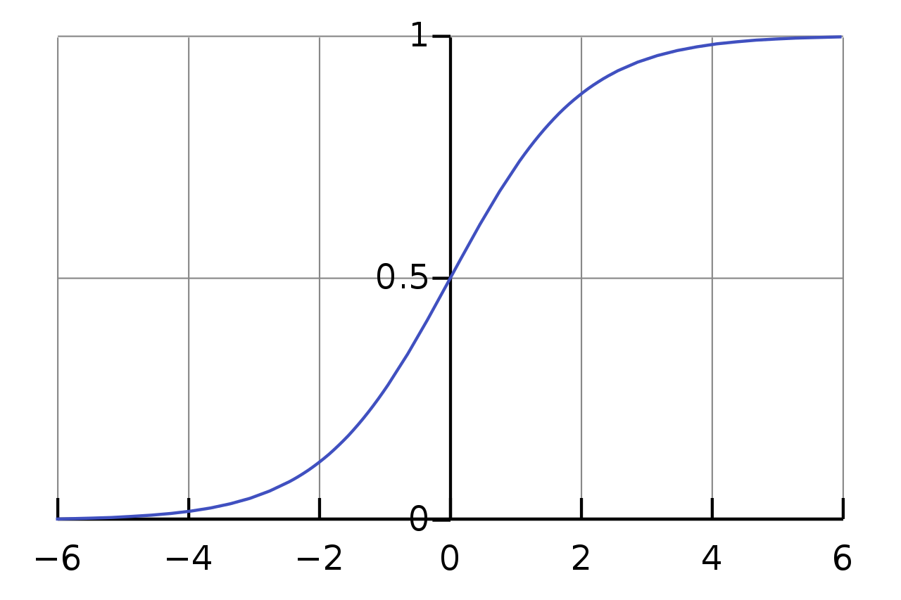
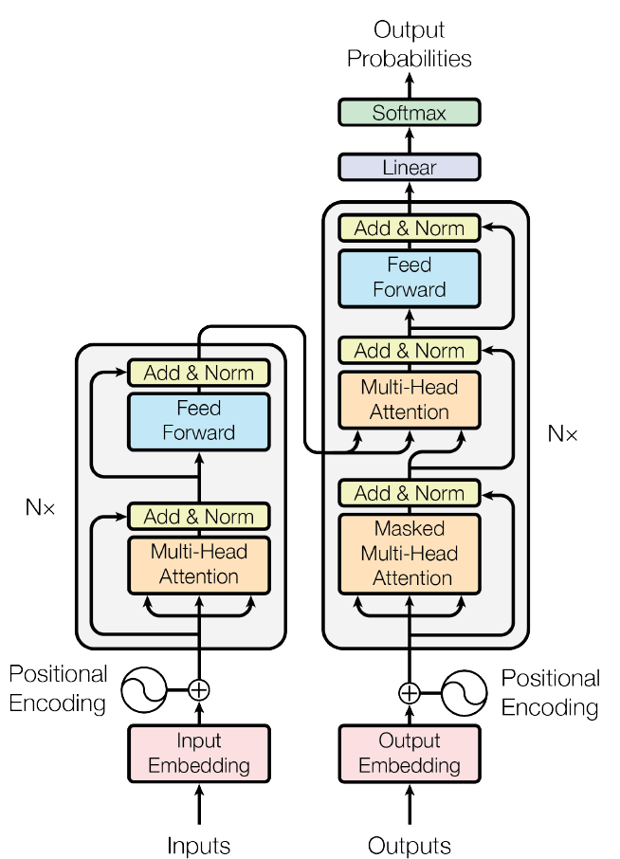
Two Machine Learning Models
Logistic Regression
BERT

Slide 5

Demonstration

Slide 6
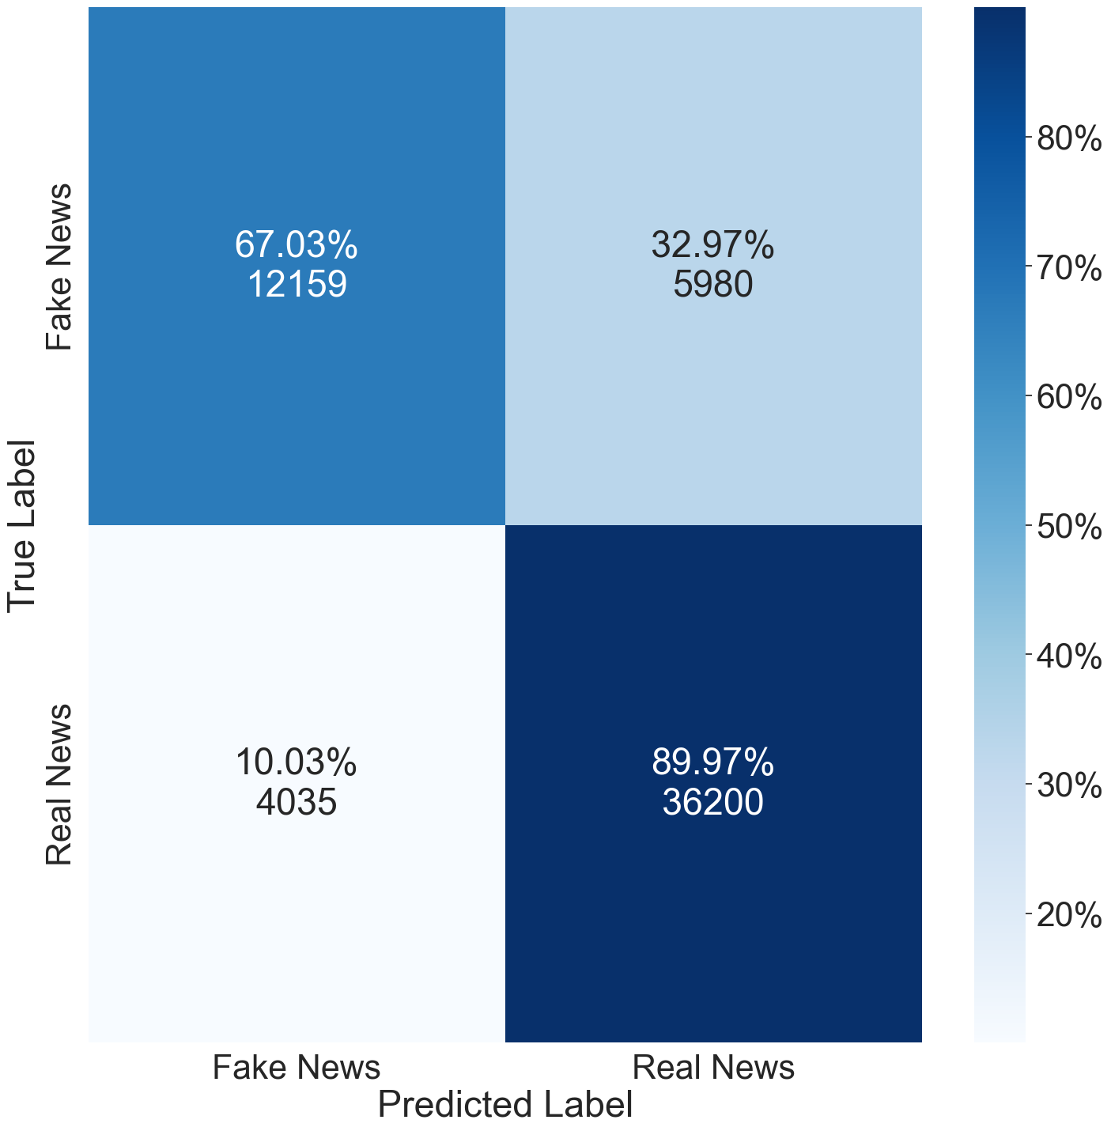
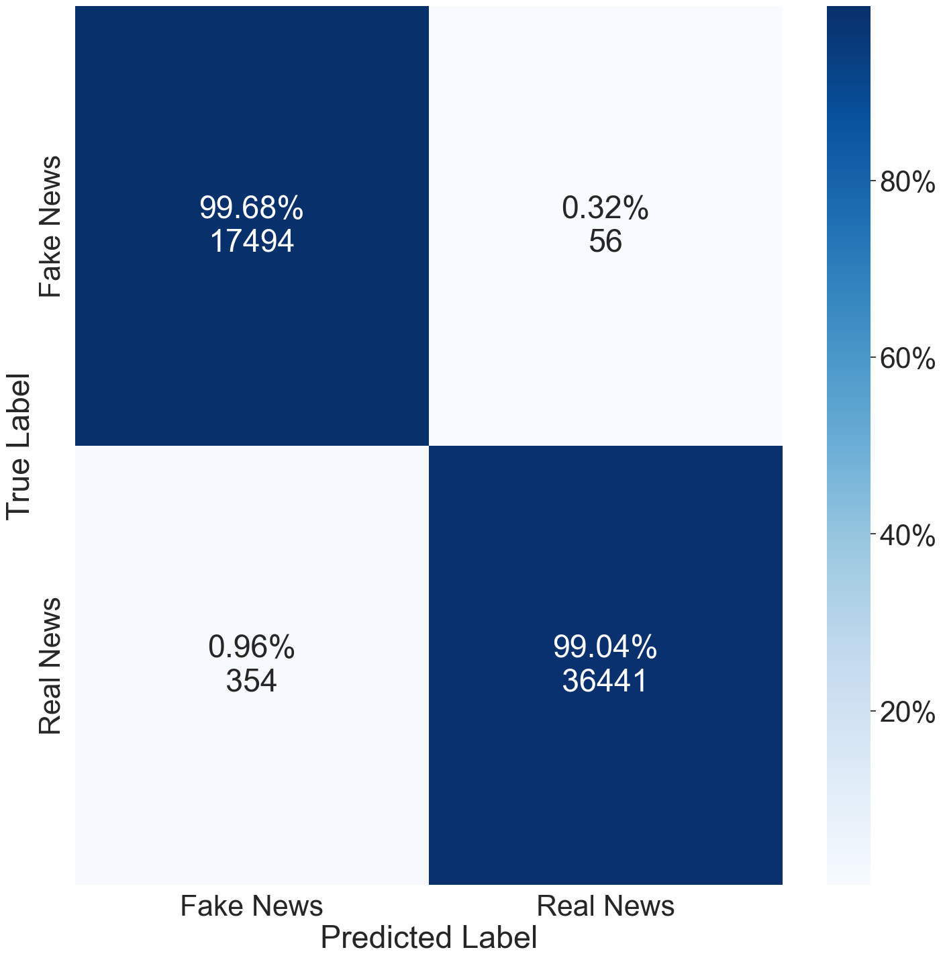
Evaluation
Logistic Regression: 82.6% F1
BERT: 99.4% F1

